Slide 1
Install instruction

Slide 2
Link
MySQL
https://dev.mysql.com/downloads/mysql/
MySQL WorkBench
http://www.microsoft.com/en-us/download/details.aspx?id=22985

Slide 3
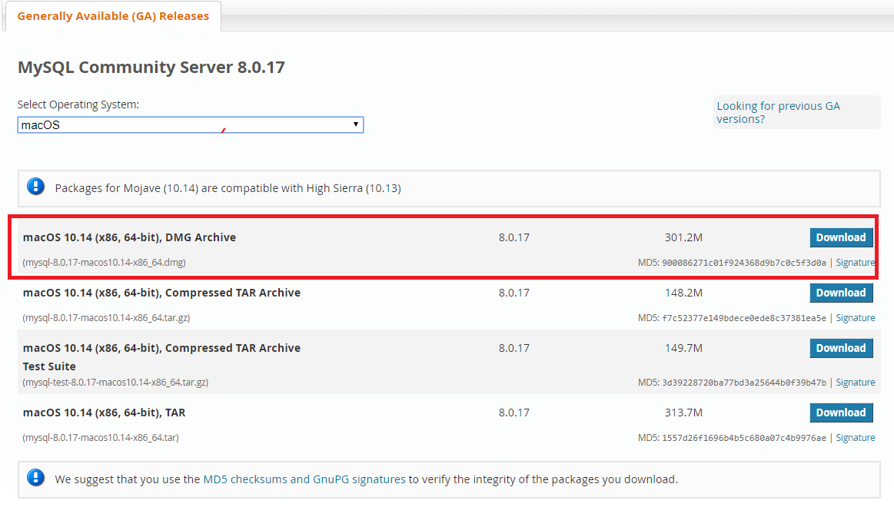
MySQL Mac

Slide 4
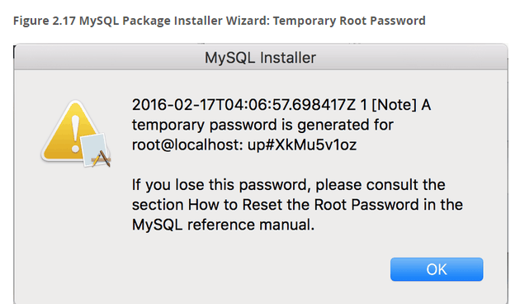
MySQL Mac
Save this password

Slide 5
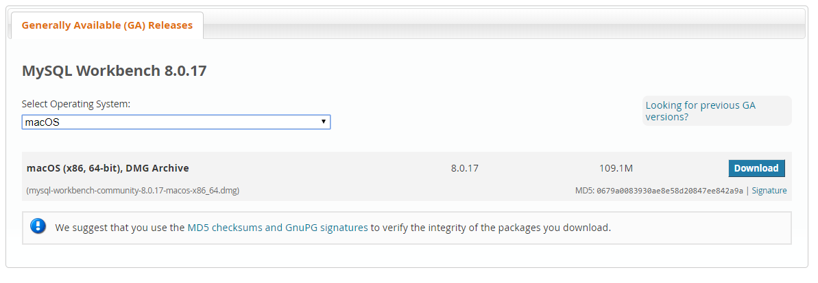
MySQL Mac
Then, download WorkBench

Slide 6
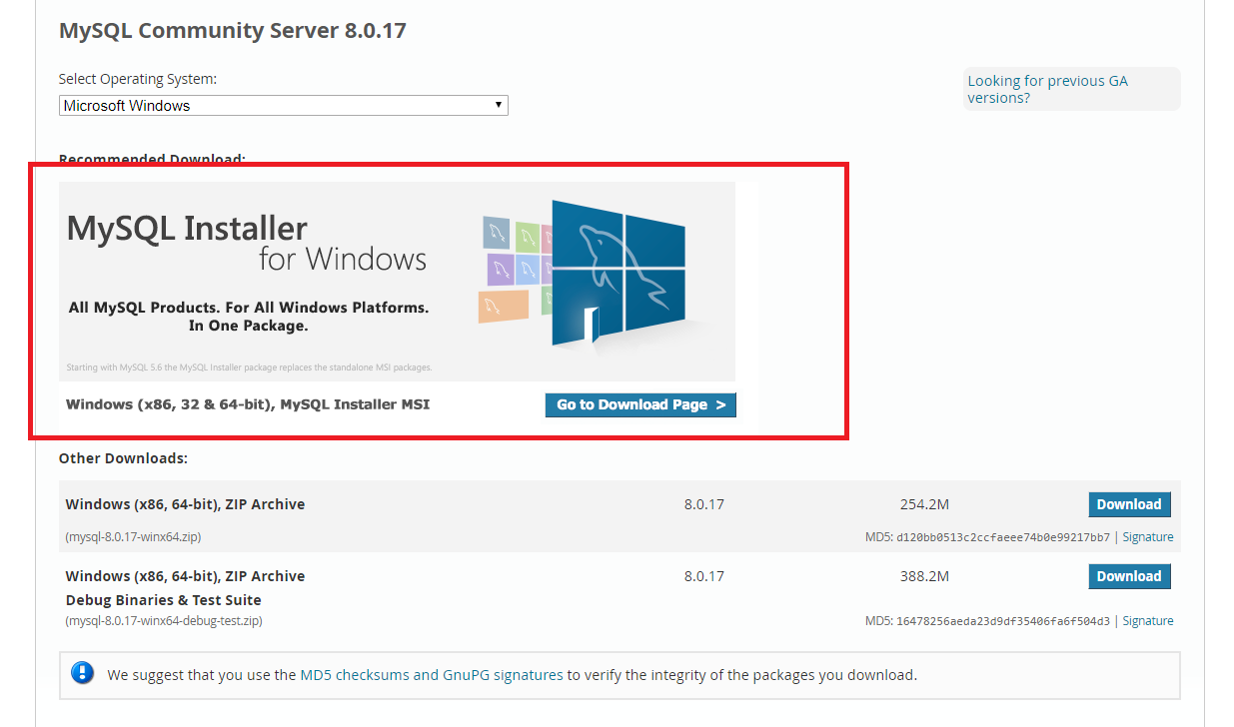
MySQL Windows

Slide 7
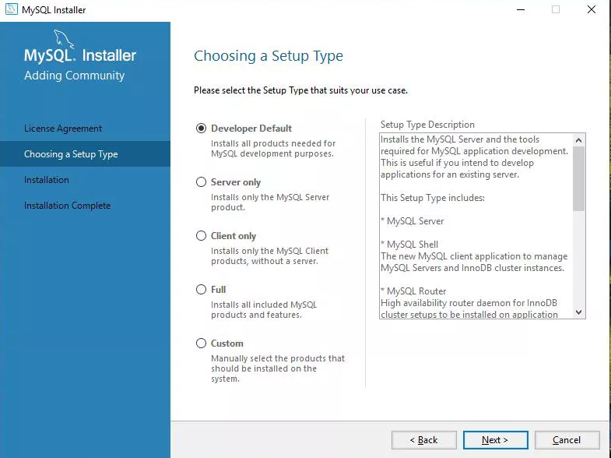
MySQL Server Windows
Choose “Custom”

Slide 8
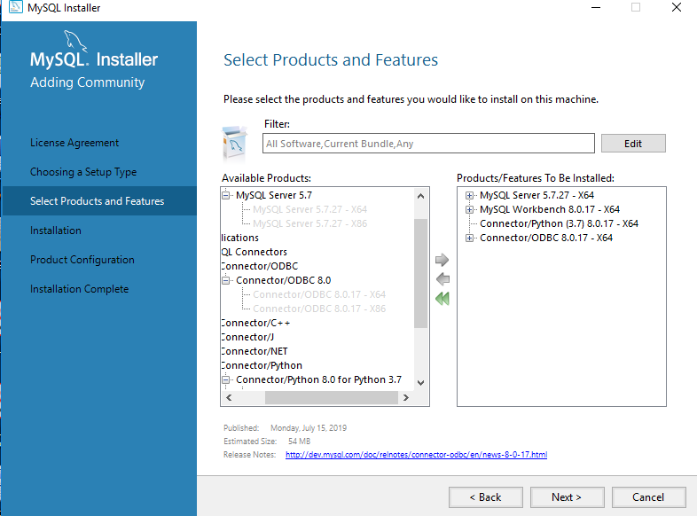
MySQL Server Windows
We Need MySQL Server MySQL Workbench Python Connector and OBDC connector

Slide 9
MySQL Server Windows
There is no need to install MySql WorkBench separatey

